Slide 1
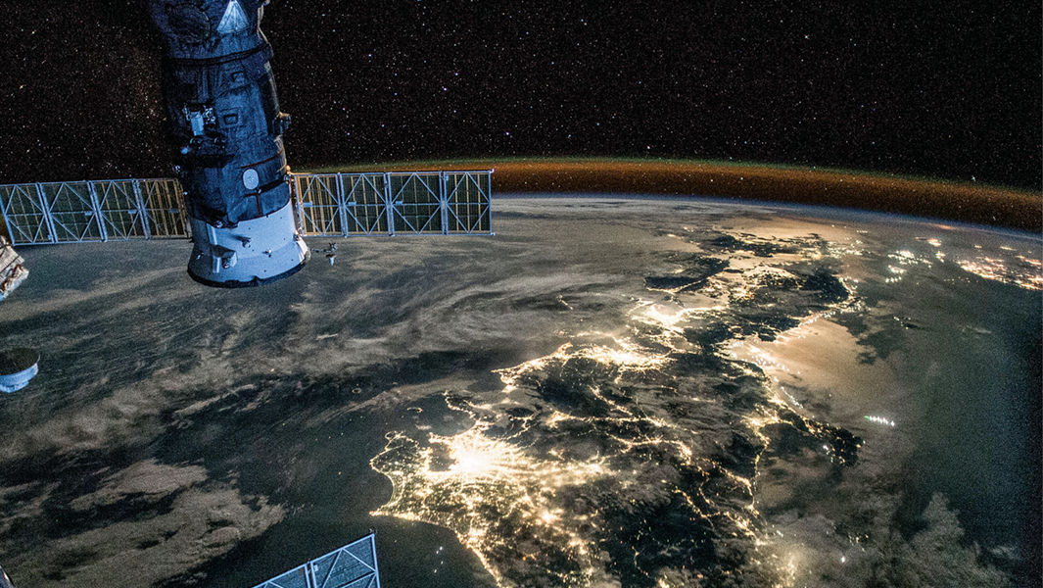
Nighttime Lights for Economic Development
Rob Marty, Data Scientist (DECDI)
Notes:
https://worldbank.github.io/OpenNightLights/tutorials/mod1_1_introduction_to_remote_sensing.html

Slide 2
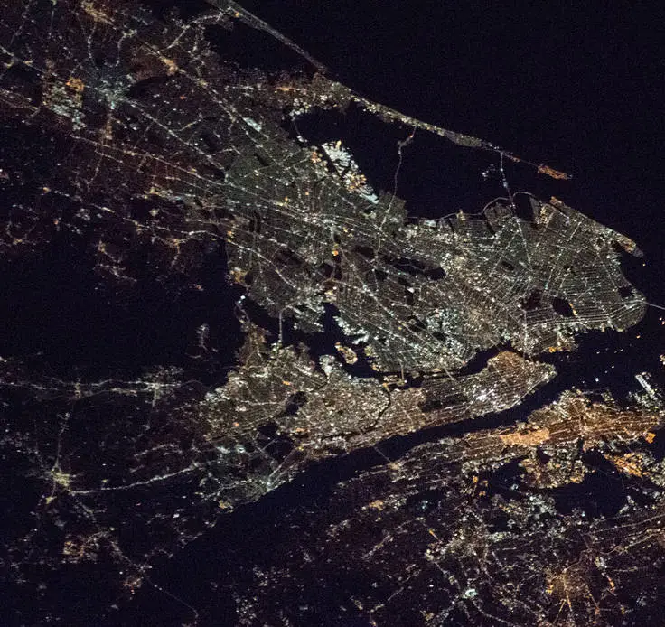
Outline
What can nighttime lights measure?
Nighttime lights data sources

Slide 3
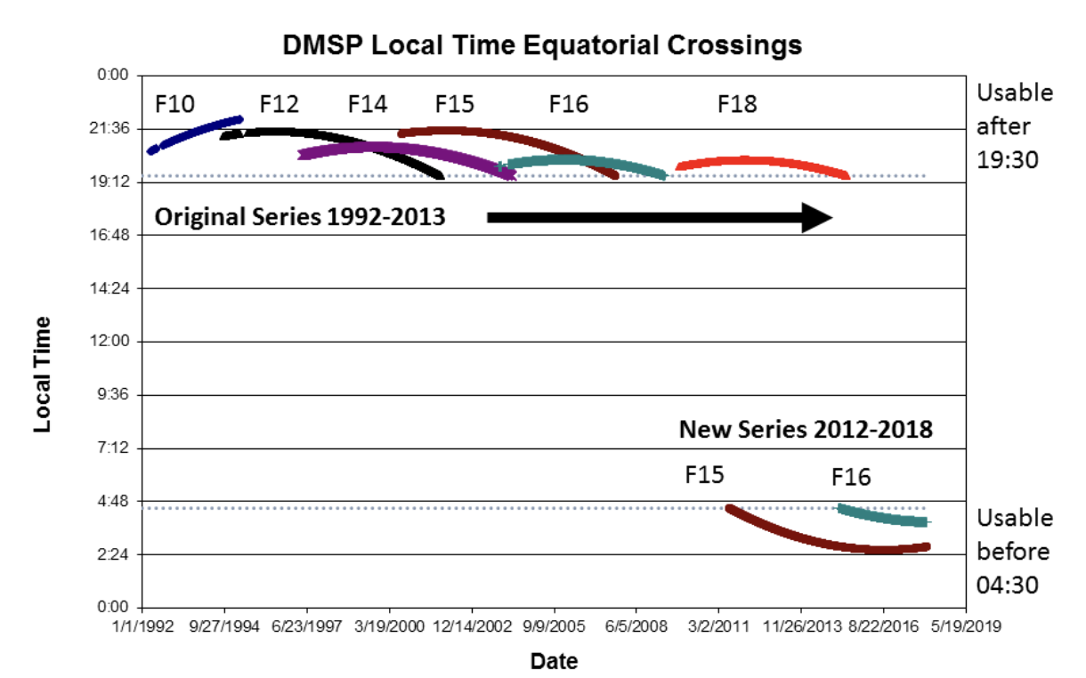
Nighttime Lights Data Sources
Defense Meteorological Satellite Program (DMSP)
Details
Original series from 1992-2013; extended to 2018
Different satellites; requires calibrating across satellites
Resolution: 30 arc second (~1km at equator)
Monthly and annual data publicly available
Where to Get Data
Google Earth Engine
Colorado School of Mines
Notes:
https://eogdata.mines.edu/products/dmsp/#dvnl

Slide 4
Nighttime Lights Data Sources
Visible Infrared Imaging Radiometer Suite (VIIRS)
Details
2012 through present
Resolution: 500 meters
Daily, monthly, and annual data publicly available
Where to get data
Notes:
https://eogdata.mines.edu/products/dmsp/#dvnl

Slide 5
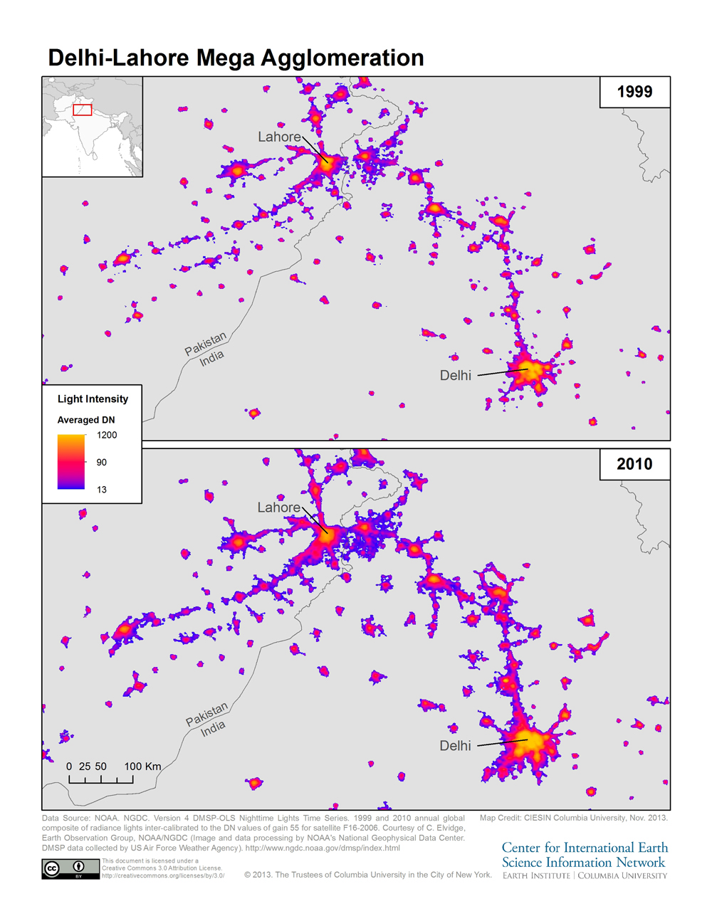
How has nighttime lights been used to capture human activity?
Identify extents of urban areas [see here]
Estimate urban population size and density [see here]
Measure electricity use, energy consumption, and GHG emissions [here]
Proxy for economic activity / GDP [see here and here]
Notes:
https://news.climate.columbia.edu/2013/11/11/night-time-lights-illuminate-trends-in-urbanization/

Slide 6
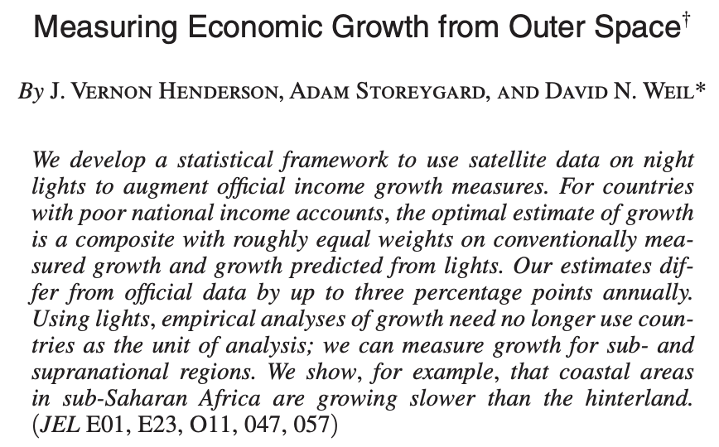
Nighttime lights & economic activity
American Economic Review, 2012
American Economic Review, 2012

Slide 7
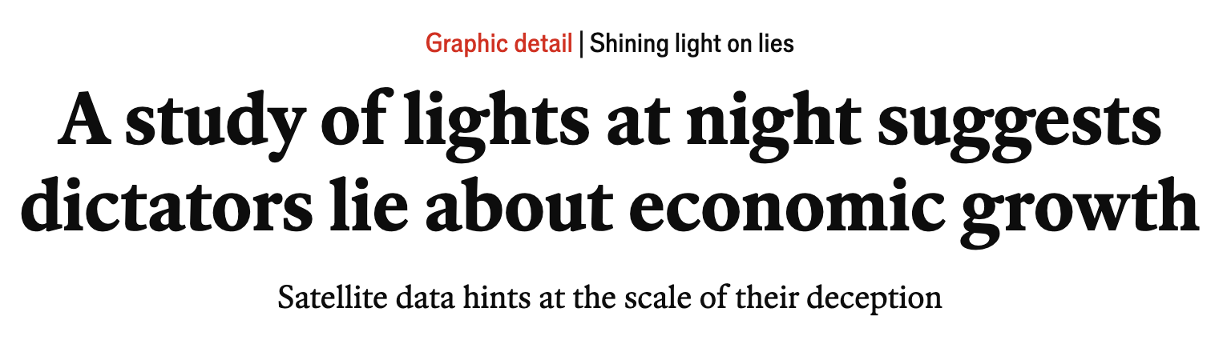
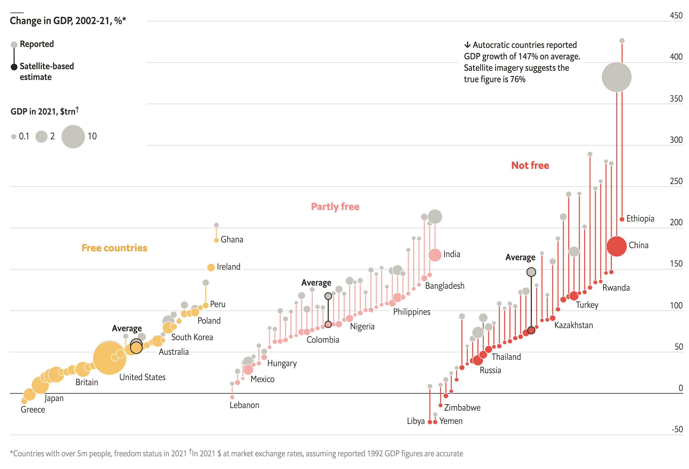
Study compares growth rate in country-level NTL & GDP
Less free countries = larger discrepancies
Luis Martinez (2018) How Much Should We Trust the Dictator’s GDP Estimates?

Slide 8
How does nighttime lights capture economic activity?
“[N]ight-time lights do provide a robust indicator of such activity albeit the relationship seems to be statistically stronger for developing economies than developed ones. In the developed economies the services sector, which are less reliant on physical infrastructure, account for a greater proportion of overall economic output and artificial light generation might exhibit decreasing elasticity of demand as income levels rise.”
Argues that service sector produce less lights (e.g., compared to manufacturing); elasticity of lights to GDP declines as income rises / country moves to service sector
—Mellander et al., 2015
Notes:
https://www.spglobal.com/market-intelligence/en/news-insights/research/how-nighttime-lights-illuminate-economic-activity

Slide 9
How does nighttime lights capture economic activity?
In Sweden, NTL strongly associated with population & establishment density; weaker association with wages. NTL may be particularly good indicator of degree of urbanization. (Mellander et al., 2015).
Nighttime lights may not explain value-added from agriculture & forestry (Keola et al. 2015).
Notes:
https://www.spglobal.com/market-intelligence/en/news-insights/research/how-nighttime-lights-illuminate-economic-activity

Slide 10
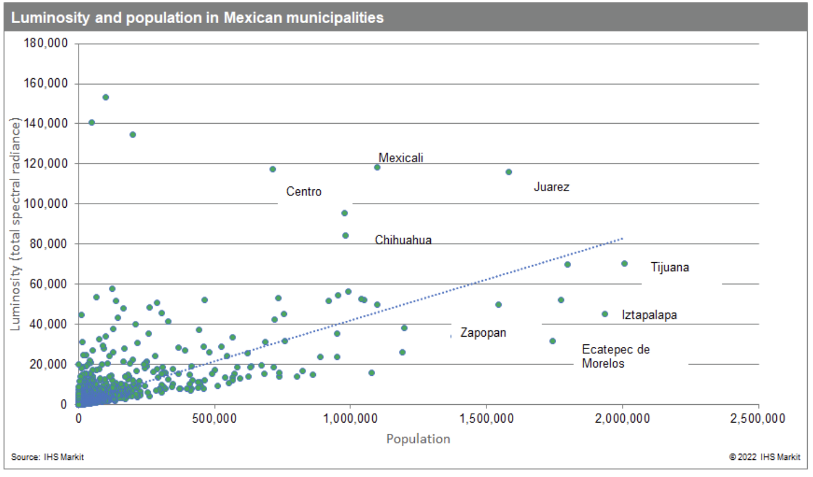
How does nighttime lights capture economic activity?
Analysis of Mexican municipalities (article from Hugo Foster & Marie Lechler, 2022)
More luminosity than expected given population in key border crossing locations with large cargo infrastructure & manufacturing activities
Strong NTL in key supply chain & industry nodes, such as ports & oil/gas facilities
Less luminosity than expected given population in poorer locations
Notes:
https://www.spglobal.com/market-intelligence/en/news-insights/research/how-nighttime-lights-illuminate-economic-activity

Slide 11
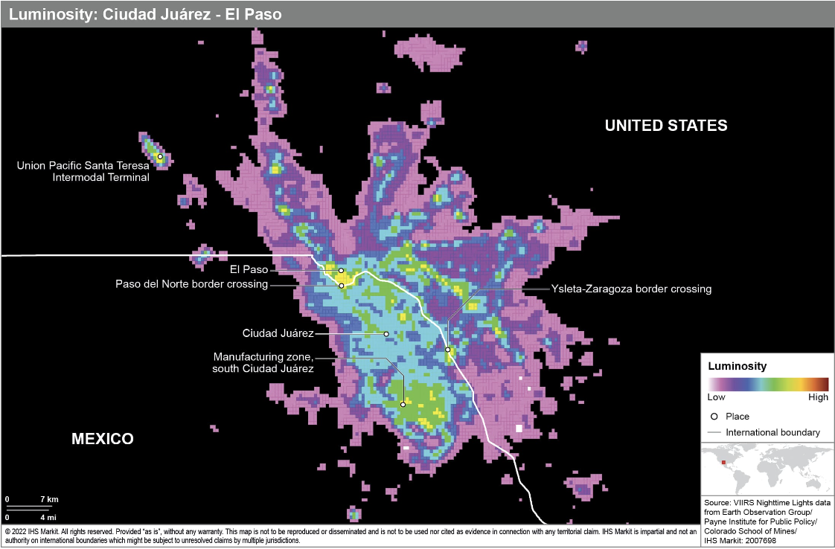
How does nighttime lights capture economic activity?
Analysis of Mexican municipalities (article from Hugo Foster & Marie Lechler, 2022)
Within Juarez-El Paso, more nighttime lights
Around border crossings
Transportation terminals
Manufacturing sites
Notes:
https://www.spglobal.com/market-intelligence/en/news-insights/research/how-nighttime-lights-illuminate-economic-activity

Slide 12
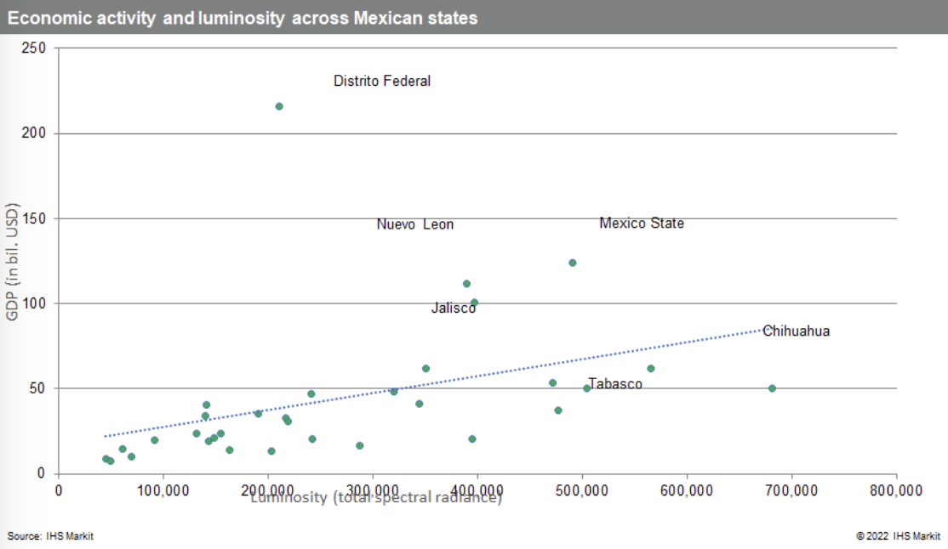
How does nighttime lights capture economic activity?
Analysis of Mexican municipalities (article from Hugo Foster & Marie Lechler, 2022)
States with more NTL tend to have higher economic output
Mexico City (Distrito Federal) is outlier; high NTL within cities can be generated by assets with varying relevance to economic activity: factories, stadiums, housing
“Luminosity data is less likely to be useful where local economies are based around service industries that emit less light compared to manufacturing”
Notes:
https://www.spglobal.com/market-intelligence/en/news-insights/research/how-nighttime-lights-illuminate-economic-activity

Slide 13
Beyond nighttime lights: indicators using nighttime lights and other data sources
Notes:
https://www.spglobal.com/market-intelligence/en/news-insights/research/how-nighttime-lights-illuminate-economic-activity

Slide 14
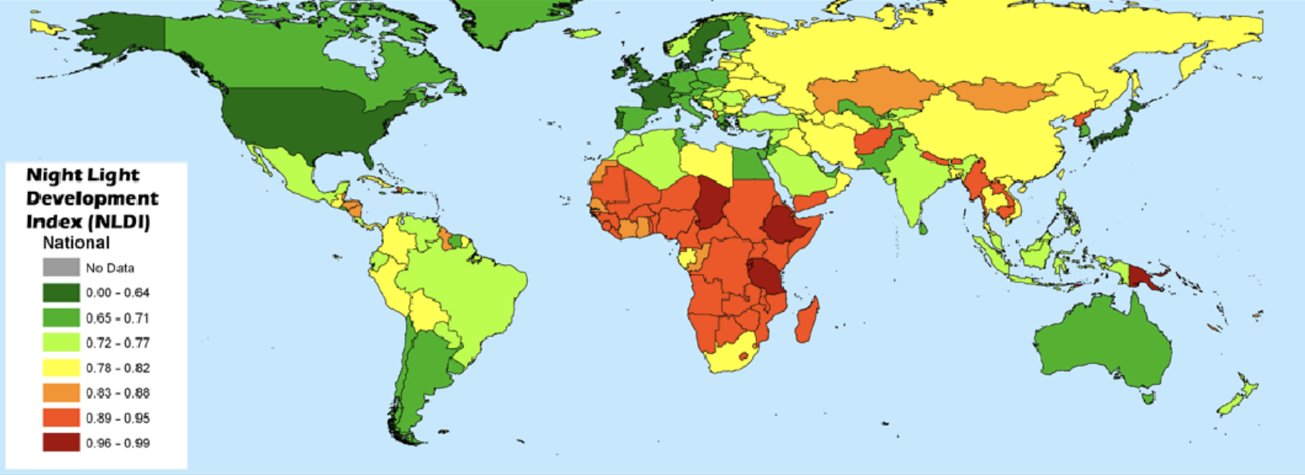
Night Light Development Index
Notes:
https://www.spglobal.com/market-intelligence/en/news-insights/research/how-nighttime-lights-illuminate-economic-activity

Slide 15
How to compare NTL with GDP -> per capita?
Notes:
https://www.spglobal.com/market-intelligence/en/news-insights/research/how-nighttime-lights-illuminate-economic-activity

Slide 16
Cloud cover
Notes:
https://www.spglobal.com/market-intelligence/en/news-insights/research/how-nighttime-lights-illuminate-economic-activity

